Slide 1


Analysis of Quantitative data
Linear and non-linear relationships
Anne Segonds-Pichon v2020-08

Slide 2
Association between 2 continuous variables
Linear relationship

Slide 3
Signal-to-noise ratio
Signal
Similarity
=
Noise
Variability
Signal
= statistical significance
Noise
Signal
= no statistical significance
Noise

Slide 4
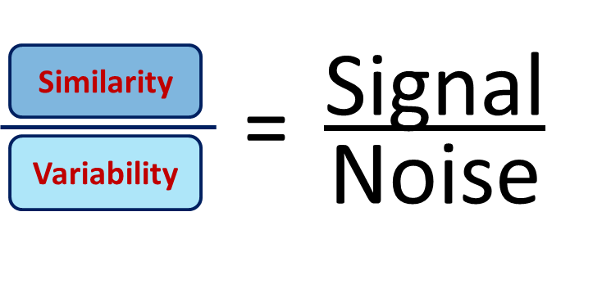
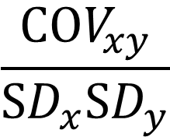
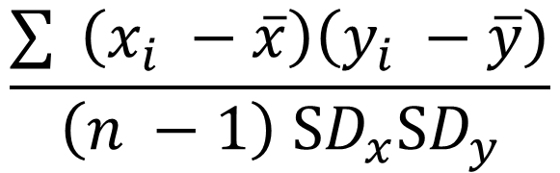
Signal-to-noise ratio and Correlation
Signal is similarity of behaviour between variable x and variable y.
similarity
Signal
Coefficient of correlation: r =
=
variability
Noise
covariance
$$\frac{COV_{xy}}{SD_{x}SD_{y}}$$
$$\frac{\sum{ }\left(x_{i} −\overline{x}\right)\left(y_{i} −\overline{y}\right)}{\left(n −1\right) SD_{x}SD_{y}}$$
r
similarity
variability
Standard Deviation

Slide 5
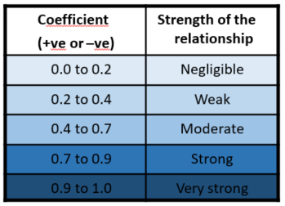
Correlation
Most widely-used correlation coefficient:
  Pearson product-moment correlation coefficient “r”
    The magnitude and the direction of the relation between 2 variables
    It is designed to range in value between -1 and +1
    -0.6 < r > +0.6 : exciting
  Coefficient of determination “r²”
    It gives the proportion of variance in Y that can be explained by X (in percentage).
      It helps with the interpretation of r
      It’s basically the effect size

Slide 6




Correlation
p = 0.0002
p = 0.04
r = - 0.34
r = - 0.83
r² = 0.12
r² = 0.68
Power!!

Slide 7
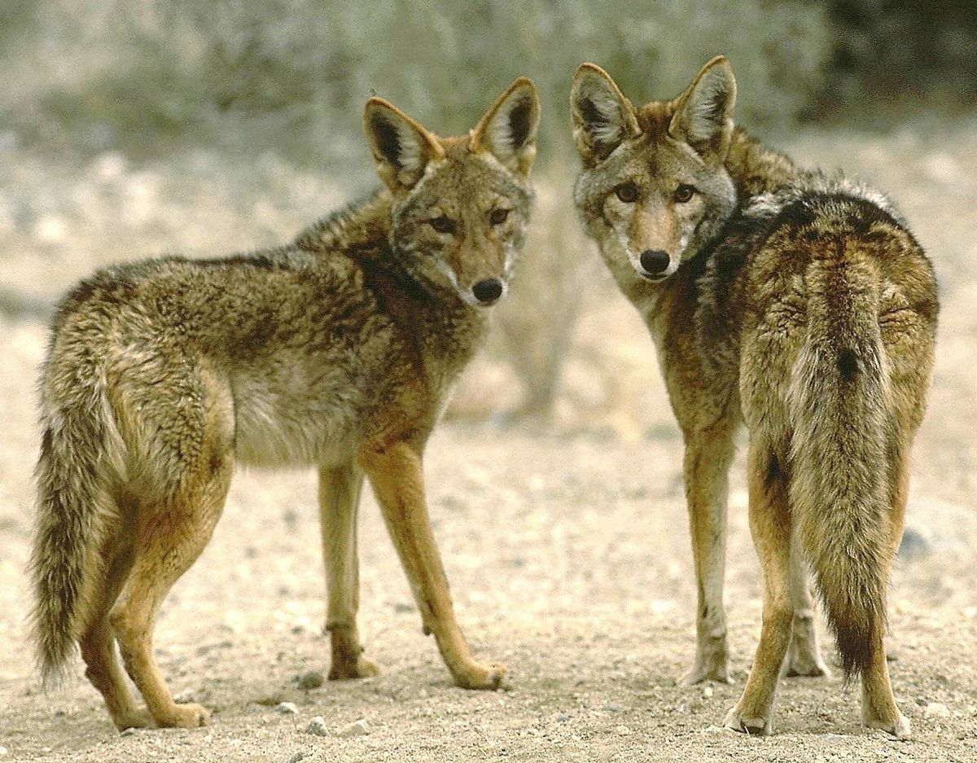
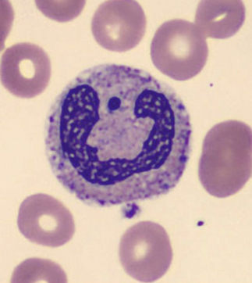
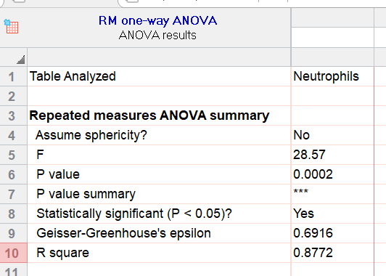
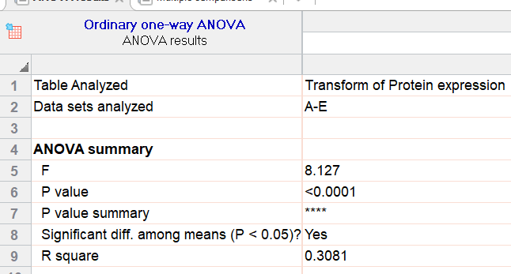
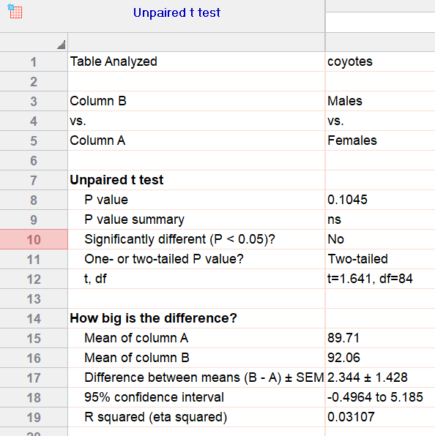
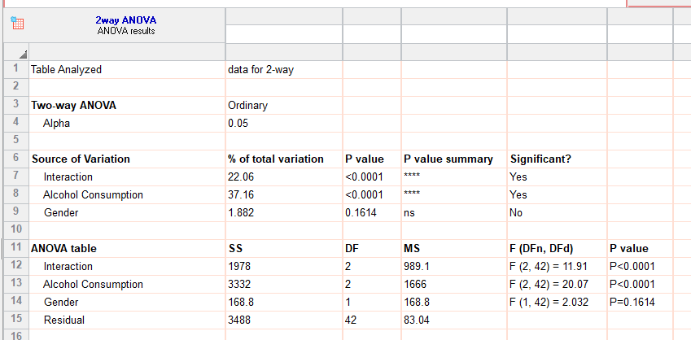
Coefficient of determination
5 cell lines on protein expression
88%
31%
Beer goggles effect
3%
22%+37%+1.88% = 61%

Slide 8
Correlation: Two more things
Thing 1: Pearson correlation is a parametric test
First assumption for parametric test: Normality
Correlation: bivariate Gaussian distribution
Symmetry-ish of the values on either side of the line of best fit.

Slide 9
Correlation: Two more things
Thing 2: Line of best fit comes from a regression
Correlation: nature and strength of the association
Regression: nature and strength of the association and prediction
Y
x
Correlation = Association
Regression = Prediction
Y = A*X + B

Slide 10

Correlation
treelight.xlsx
Amount of light in a tree
Have a go!

Slide 11
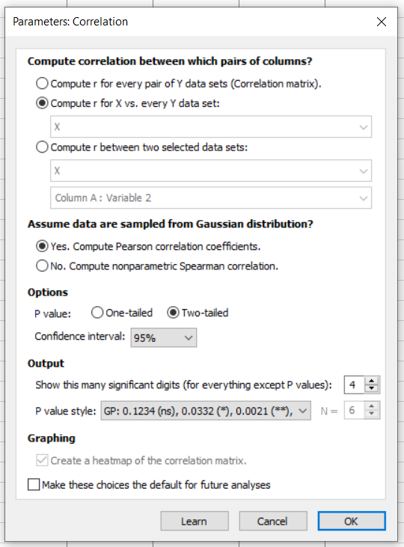
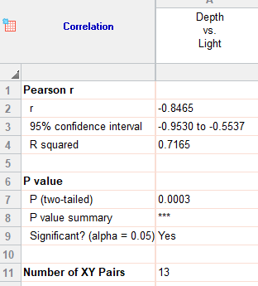
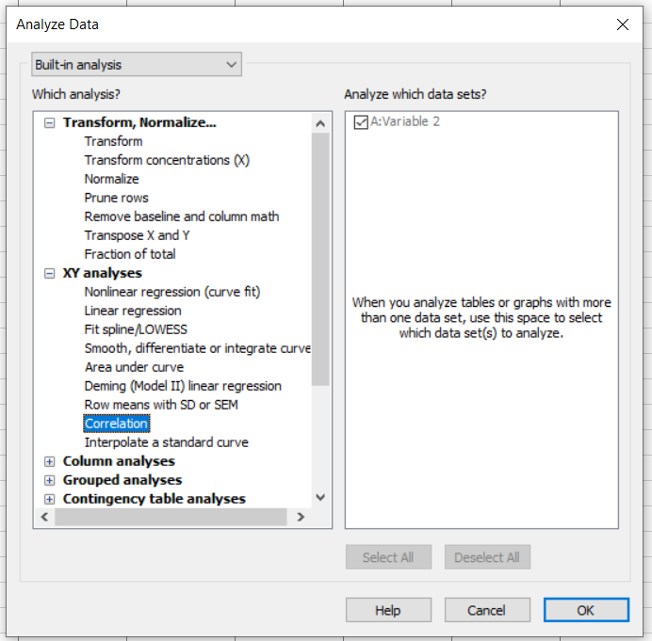
Correlation with Prism 8
Results
Results
Association
Normality
Strong
Negative
Non-directional
Significant

Slide 12
Correlation with Prism 8
Amount of light in a tree
r = - 0.85 , p = 0.0003, r² = 72%

Slide 13
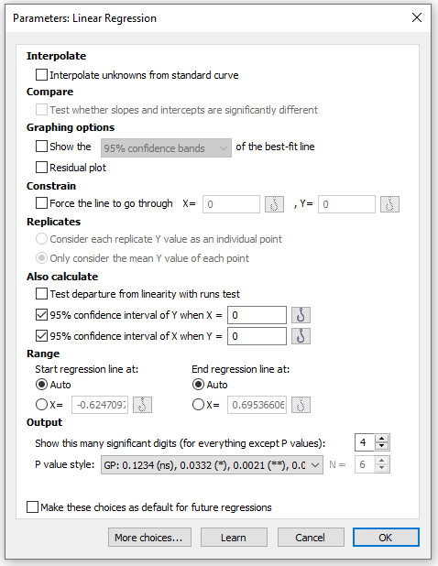
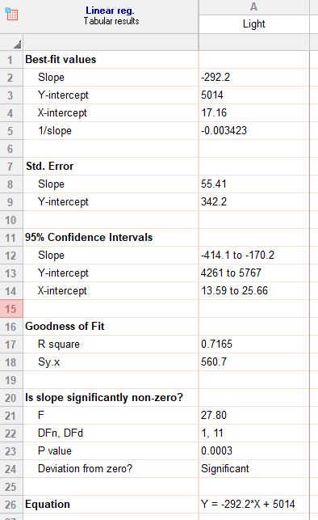
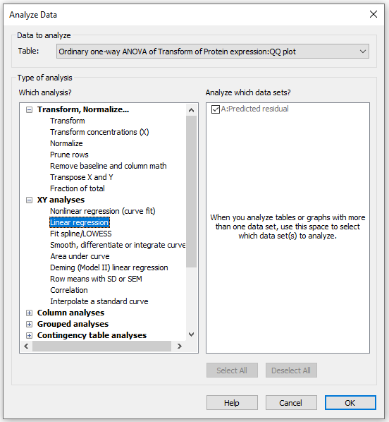
Correlation with Prism 8
(if you also want a line of best fit)
Results
Results
Prediction

Slide 14
Correlation with Prism 8
Amount of light in a tree
Y = -292.2*X + 5014
r = - 0.85 , p = 0.0003, r² = 72%

Slide 15
Association between 2 continuous variables
Non-linear relationship

Slide 16
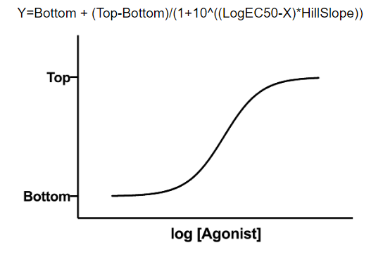
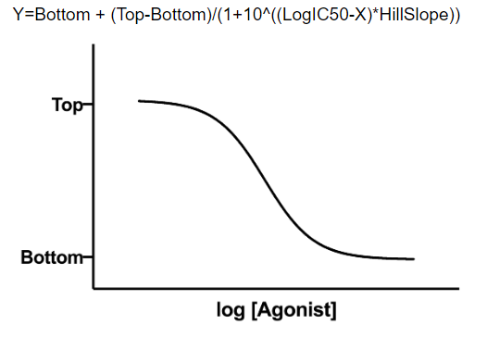
Curve fitting
Dose-response curves
  Nonlinear regression
  Dose-response experiments typically use around 5-10 doses of agonist, equally spaced on a logarithmic scale
  Y values are responses
The aim is often to determine the IC50 or the EC50
  IC50 (I=Inhibition): concentration of an agonist that provokes a response half way between the maximal (Top) response and the maximally inhibited (Bottom) response.
  EC50 (E=Effective): concentration that gives half-maximal response

Slide 17

Curve fitting
Example: Inhibition data.xlsx
Step by step analysis and considerations:
1- Choose a Model:
2- Choose a Method
3- Compare different conditions

Slide 18
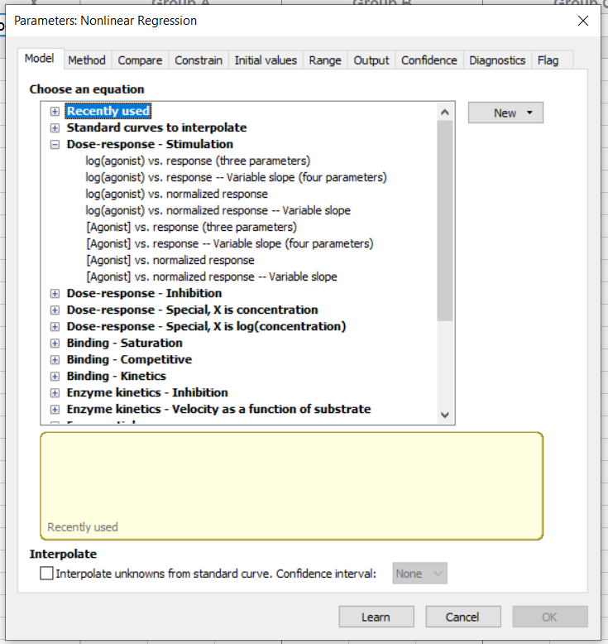
Curve fitting
Example: Inhibition data.xlsx
Step by step analysis and considerations:
1- Choose a Model

Slide 19
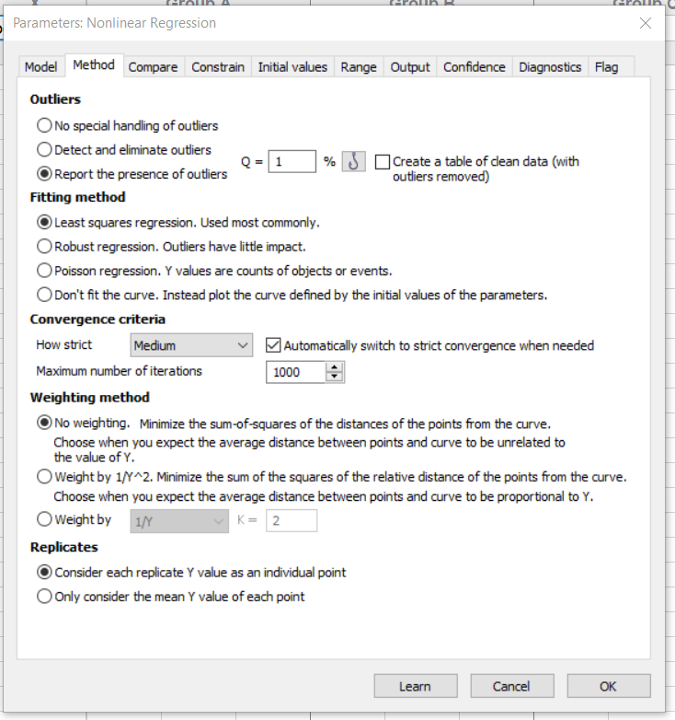
Curve fitting
Example: Inhibition data.xlsx
Step by step analysis and considerations:
2- Choose a Method:

Slide 20
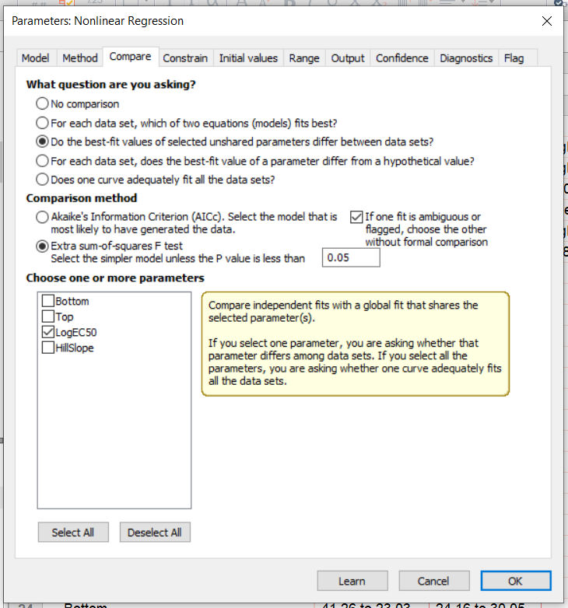
Curve fitting
Example: Inhibition data.xlsx
Step by step analysis and considerations:
3- Compare different conditions:

Slide 21
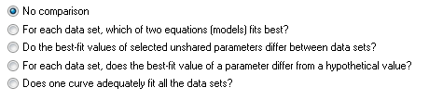
Curve fitting
Example: Inhibition data.xlsx
Step by step analysis and considerations:
1- Choose a Model:
not necessary to normalise
should choose it when values defining 0 and 100 are precise
variable slope better if plenty of data points (variable slope or 4 parameters)
2- Choose a Method: outliers, fitting method, weighting method and replicates
3- Compare different conditions:
4- Constrain:
depends on your experiment
depends if your data don’t define the top or the bottom of the curve
Diff in parameters
Diff between conditions for one or more parameters
Constraint vs no constraint
Diff between conditions for one or more parameters

Slide 22
Curve fitting
Example: Inhibition data.xlsx
Step by step analysis and considerations:
5- Initial values:
defaults usually OK unless the fit looks funny
6- Range:
defaults usually OK unless you are not interested in the x-variable full range (ie time)
7- Output:
summary table presents same results in a … summarized way.
8 – Confidence: calculate and plot confidence intervals
9- Diagnostics:
check for normality (weights) and outliers (but keep them in the analysis)
check Replicates test
residual plots

Slide 23
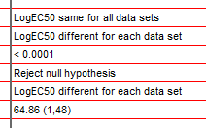
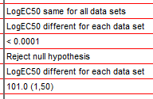
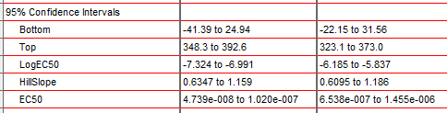
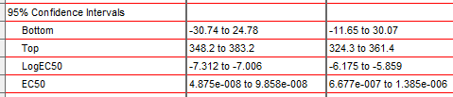
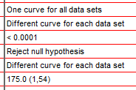
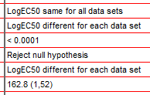


Curve fitting

Slide 24
Curve fitting
No inhibitor | Inhibitor
Replicates test for lack of fit
SD replicates | 22.71 | 25.52
SD lack of fit | 41.84 | 32.38
Discrepancy (F) | 3.393 | 1.610
P value | 0.0247 | 0.1989
Evidence of inadequate model? | Yes | No
Replicates test for lack of fit
SD replicates | 22.71 | 25.52
SD lack of fit | 39.22 | 30.61
Discrepancy (F) | 2.982 | 1.438
P value | 0.0334 | 0.2478
Evidence of inadequate model? | Yes | No
Replicates test for lack of fit
SD replicates | 5.755 | 7.100
SD lack of fit | 11.00 | 8.379
Discrepancy (F) | 3.656 | 1.393
P value | 0.0125 | 0.2618
Evidence of inadequate model? | Yes | No
Replicates test for lack of fit
SD replicates | 5.755 | 7.100
SD lack of fit | 12.28 | 9.649
Discrepancy (F) | 4.553 | 1.847
P value | 0.0036 | 0.1246
Evidence of inadequate model? | Yes | No
Have a go!

Slide 25
Association between 2 continuous variables
Linear relationship
Diagnostics: Goodness-of-fit

Slide 26
Regression: Goodness of fit
Question: Is there a relationship between time spent revising (Revise) and exam anxiety (Anxiety)? And, if yes, are boys and girls different?
Focus: how good is the model?

Slide 27
Regression: Goodness of fit
Set of 5 clues
Clue 1: Graphical exploration of the data: linearity
Clue 2: Identification of outliers
Clue 3: R², the Coefficient of determination
Clue 4: Distribution of residuals with statistical tests
Clue 5: Distribution of residuals with a QQ plot

Slide 28
Regression: Goodness of fit
Clue 1: Graphical exploration of the data

Slide 29
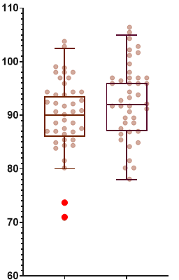
Regression: Goodness of fit
Clue 2: Identification of outliers
Categorical x and continuous y
Continuous x and continuous y

Slide 30
Regression: Goodness of fit
Clue 3: Coefficient of determination
R² = 76%
R² = 46%

Slide 31
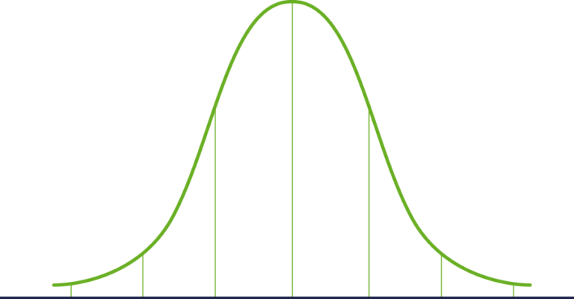
Regression: Goodness of fit
Distribution of the residuals
Residuals: difference between each point
and the predicted value (=Error)
Residuals
Distribution of Residuals

Slide 32
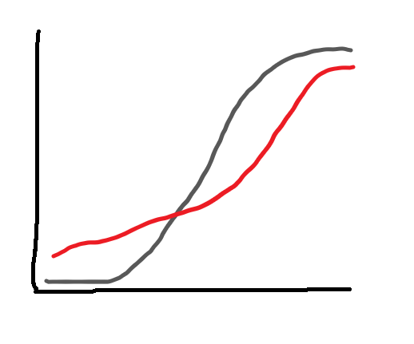
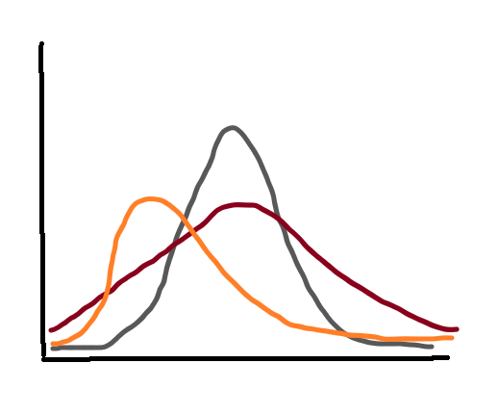
Regression: model goodness of fit
Clue 4: Distribution of the residuals with statistical tests
Statistical tests: significant departure from normality ?
  Anderson-Darling:
    cumulative distribution different from a normal one?
  D’Agostino-Pearson:
    asymmetry and shape different from normal distribution?
  Other tests: Shapiro-Wilk and Kolmogorov-Smirnov
Normal-ish
Dodgy
Dodgy
Normal-ish
Dodgy

Slide 33
Regression: Goodness of fit
Clue 5: Distribution of the residuals with QQ plot
= Quantile – Quantile plot
Same mean
Same SD
Same sample size
BUT
perfectly normal distribution

Slide 34
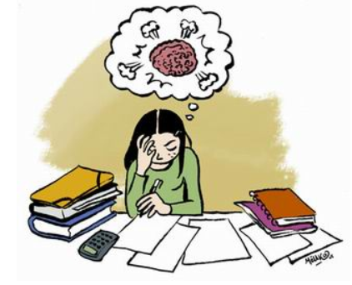
Goodness of fit: let’s do it
exam anxiety.xlsx (Don’t need ‘Exam’)
Association between time spent revising and exam anxiety.
Are we getting it right?

Slide 35
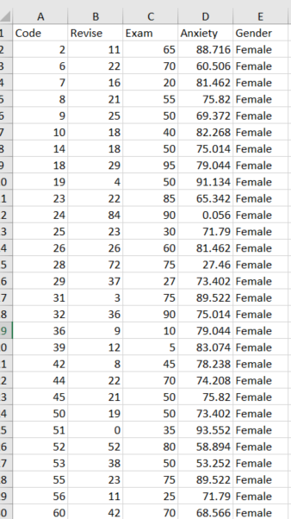
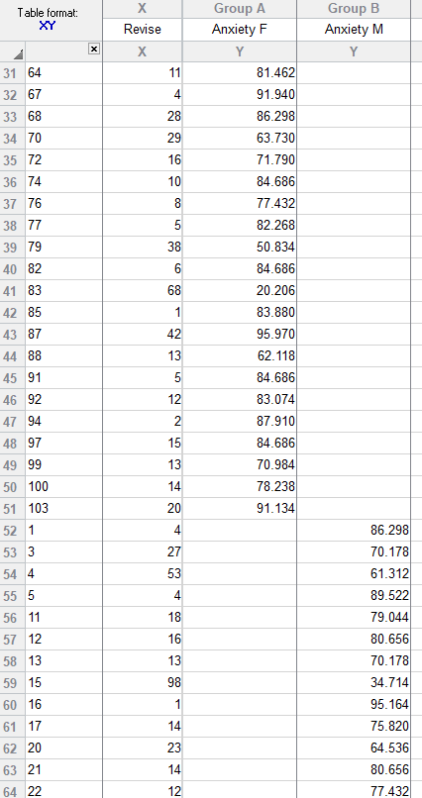
Goodness of fit: let’s do it
exam anxiety.xlsx (Don’t need ‘Exam’)
Excel File
Prism File

Slide 36
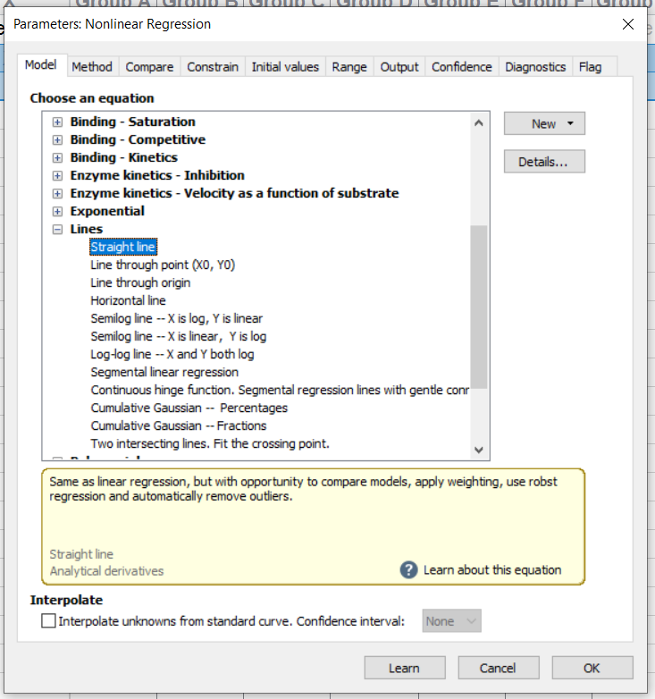
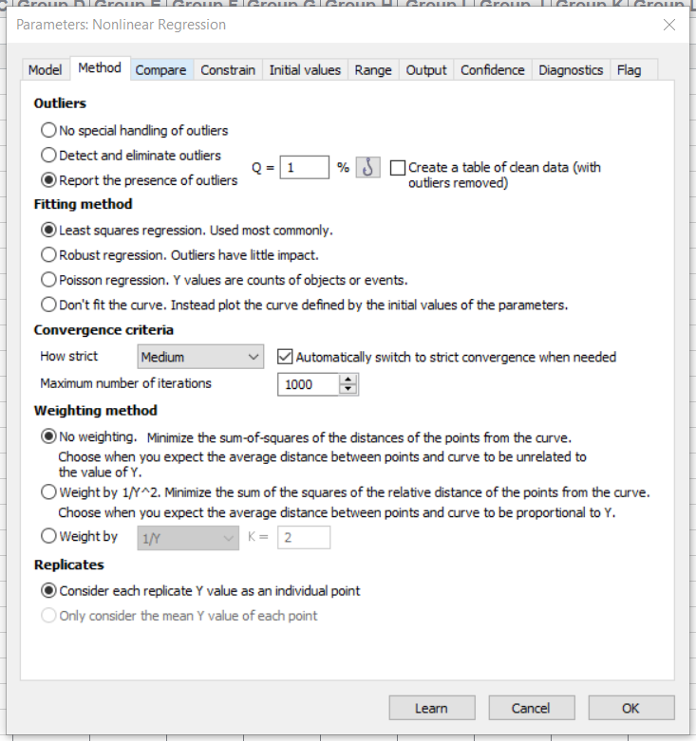
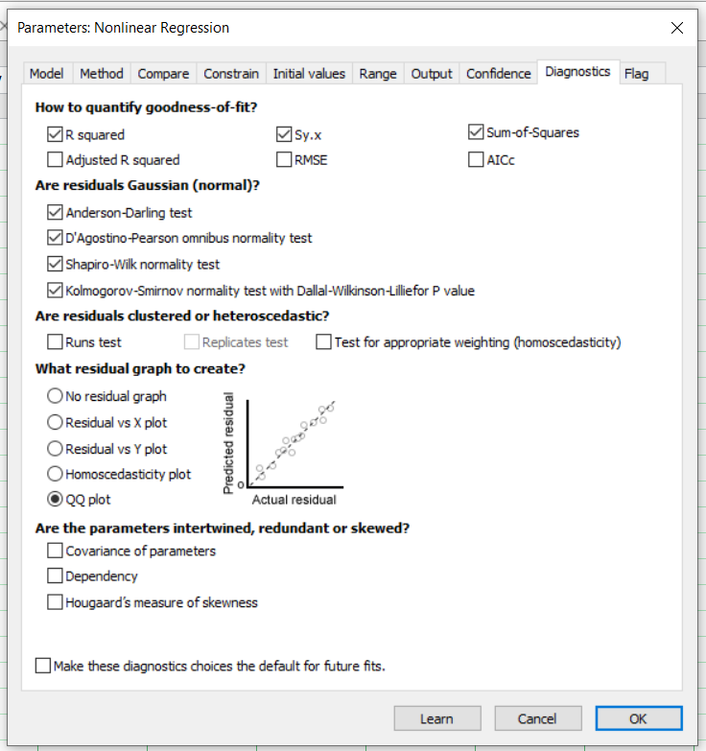
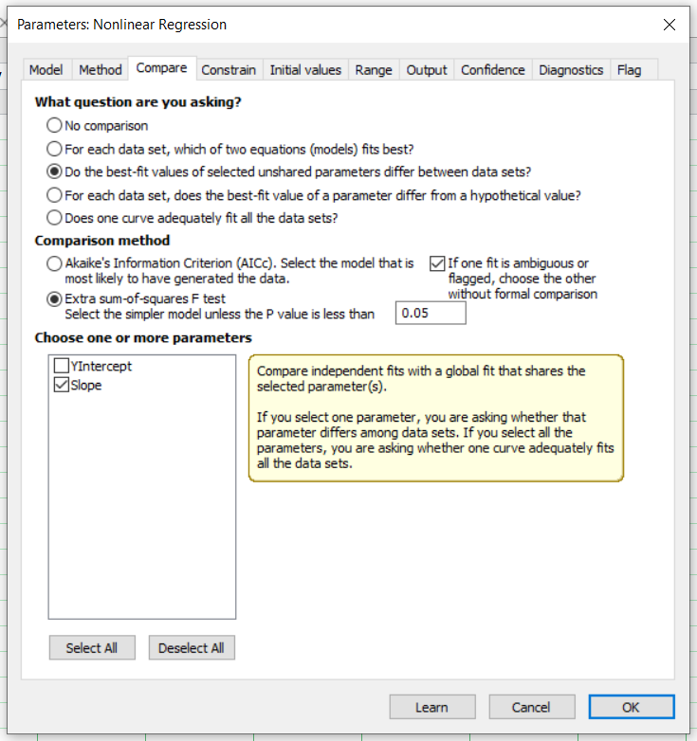
Goodness of fit with Prism 8
Clue 3
Clue 1
Clue 2
Clue 4
Clue 5
Have a go!

Slide 37
Regression: model goodness of fit
Clue 1: Graphical exploration of the data: linear relationship

Slide 38
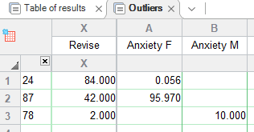
Goodness of fit with Prism 8
Clue 2: Identification of outliers
ID

Slide 39
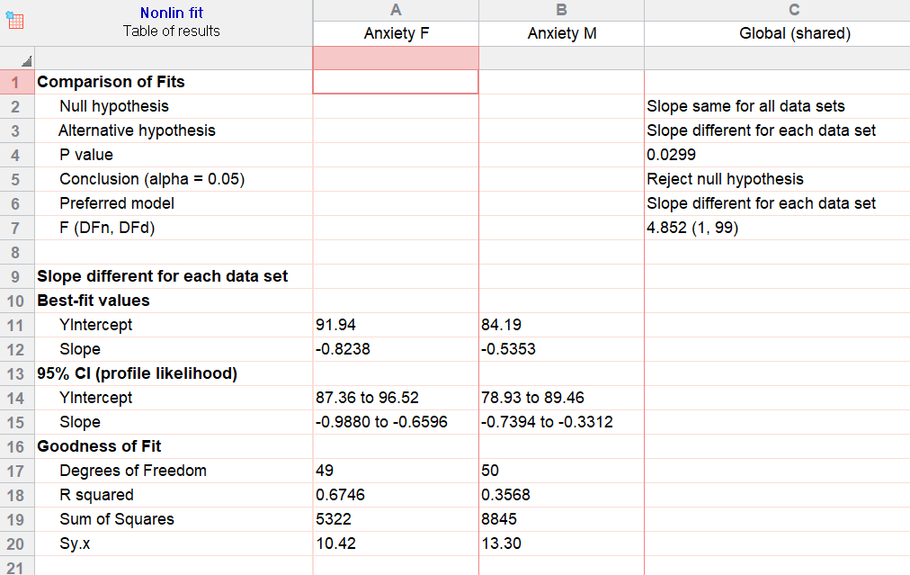
Regression: model goodness of fit
Clue 3: Coefficient of determination

Slide 40

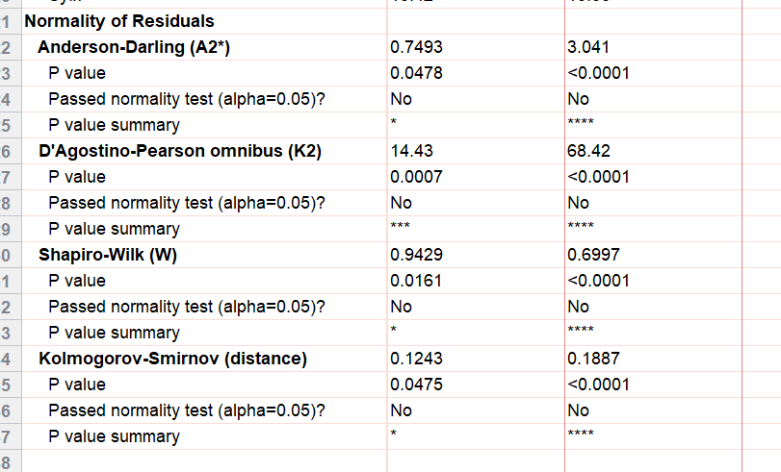
Regression: model goodness of fit
Clue 4: Distribution of the residuals with statistical tests
Significant departure
from normality
Females
Males

Slide 41
Regression: model goodness of fit
Clue 5: Distribution of the residuals with QQ plot

Slide 42
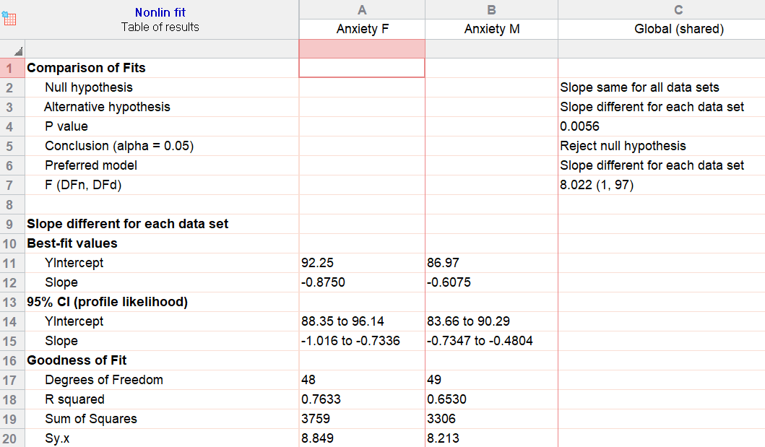
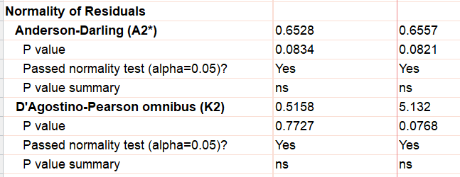

Goodness of fit with Prism 8
r = -0.61, r²=65%
r = -0.87, r²=76%
There is a strong negative relationship between time spent revising and exam anxiety and that relationship is significantly stronger for girls than for boys (p=0.0056).
Normality

